Slide 1


ACTFL Advanced Assessment Criteria
for Speaking
Catherine Baumann, Director, Chicago Language Center
April 10-11, 2026
SEALC Speaking & Writing Proficiency Assessment Design Workshop

Slide 2
create with language
carry on a conversation
ask questions
answer questions
get through a transaction
produce strings of discrete sentences
about personal, everyday topics
in familiar, informal contexts
accurate enough for sympathetic listener
Intermediate
Speaking
Assessment
Criteria
FACCTs

Slide 3
narrate, describe, explain in detail
in all time frames
get through a complicated or unexpected
situation
produce cohesive, organized discourse
about personal and public interest topics
including community, national or
international interest
in personal, as well as academic or
professional contexts
accurate enough for any listener
Advanced
Speaking
Assessment
Criteria
FACCTs

Slide 4
Sublevels in Assessment Design

Slide 5
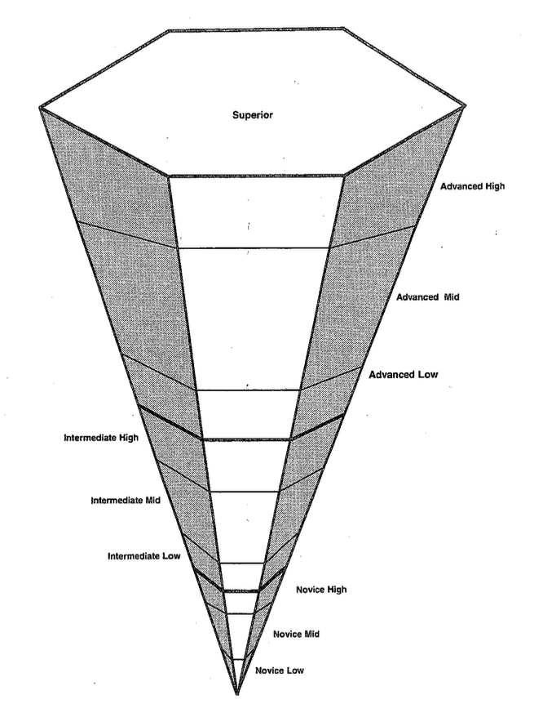
Sublevels in Rating

Slide 6
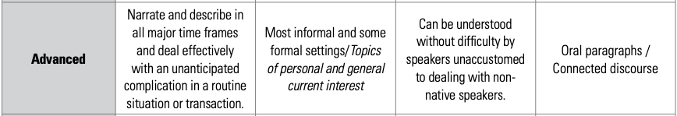
assessments vs Discrete assessments
Global Assessment

Slide 7
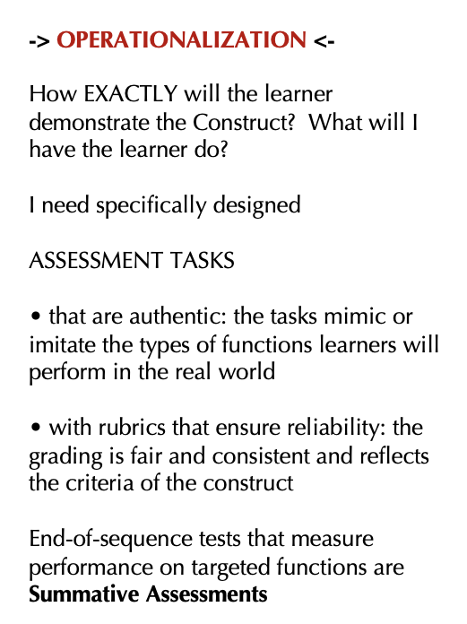
narrate, describe, explain in detail
in all time frames
get through a complicated or unexpected
situation
produce cohesive, organized discourse
about personal and public interest topics
including community, national or
international interest
in personal, as well as academic or
professional contexts
accurate enough for any listener
Operationalization
• warm-up
• 2-3 Advanced-level questions
• role play
• wind down

Slide 8
Effective Advanced- Level Questioning Strategies
narrate, describe, explain in detail
in all time frames
get through a complicated or unexpected
situation
produce cohesive, organized discourse
about personal and public interest topics
including community, national or
international interest
in personal, as well as academic or
professional contexts
accurate enough for any listener
Remember, you are eliciting evidence of the ability to:
FACCTs

Slide 9
Effective Advanced-Level Questioning Strategies
Past narration is required in every Advanced test.
Sample Advanced question:
What did you do last summer?
narrate, describe, explain
in detail
in all time frames
get through a complicated or
unexpected situation
produce cohesive, organized
discourse
about personal and public
interest topics including
community, national or
international interest
in personal, as well as academic
or professional contexts
accurate enough for any
listener
You said you took a trip to Singapore last year. Can you tell me about something that happened on that trip? Something that you’ll never forget?
You said you took a trip to Singapore last year. Can you compare Singapore to Chicago?

Slide 10
Thank you!
Questions?
ccbauman@uchicago.edu
https://www.languages.uchicago.edu

