Slide 1

Revisiting Proficiency as an Assessment Design Framework
Catherine Baumann, Director, Chicago Language Center
March 6/7, 2026
SEALC Speaking & Writing Proficiency Assessment Design Workshop

Slide 2


What do we mean by “proficiency”?

Slide 3
Learning about driving | Learning to drive the car
Rules of the road Happens in the classroom Manuals, online learning Discussions, quizzes Assessment = Written test | Driving! Happens out in the car Different skills each day Learn by doing Assessment = Driving test
Achievement Testing
Proficiency Testing

Slide 4
Achievement Testing Proficiency Testing
• what learners know about language • directly related to classroom learning and practice • test at regular, short intervals • tends to be discrete items or selected responses • instructor knows what responses to expect • can expect a high level of accuracy • learners earn a score or grade that indicates how well they have mastered the material | • what learners can do with language • tied to real-world use • longer intervals, end-of-sequences • open-ended, constructed responses • adjusted expectations • learners are given a rating that describes their functional ability
Over the next four sessions we will be designing and developing speaking and writing
proficiency assessments at the ACTFL Intermediate and Advanced levels.

Slide 5
Proficiency assessments are often criterion-referenced.
Many achievement tests are norm-referenced. Test-takers are compared to each other.
In a criterion-referenced assessment we agree on a set of criteria, get a sample of language, and compare the sample to the criteria.
What are our criteria?
The American Council on the Teaching of Foreign Languages (ACTFL) Proficiency Guidelines

Slide 6

create with language
carry on a conversation
ask questions
answer questions
get through a transaction
produce strings of discrete sentences
about personal, everyday topics
in familiar, informal contexts
accurate enough for sympathetic listener
Intermediate
Speaking
Assessment
Criteria
FACCTs

Slide 7
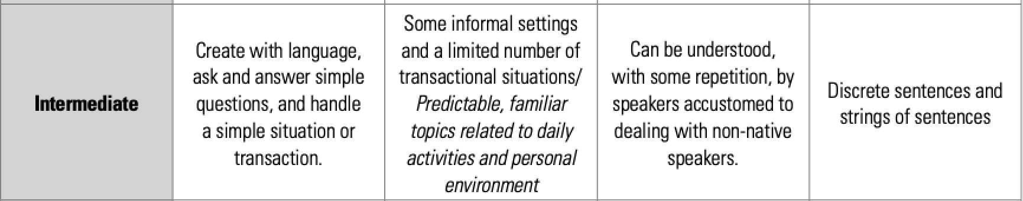
assessments vs Discrete assessments
Discrete and Global Assessments
Fill in the blank with the correct form of the verb in the present tense.
(go) Mary ___________ to the library on Saturdays.
(sit) Tom always ___________ by the window.

Slide 8
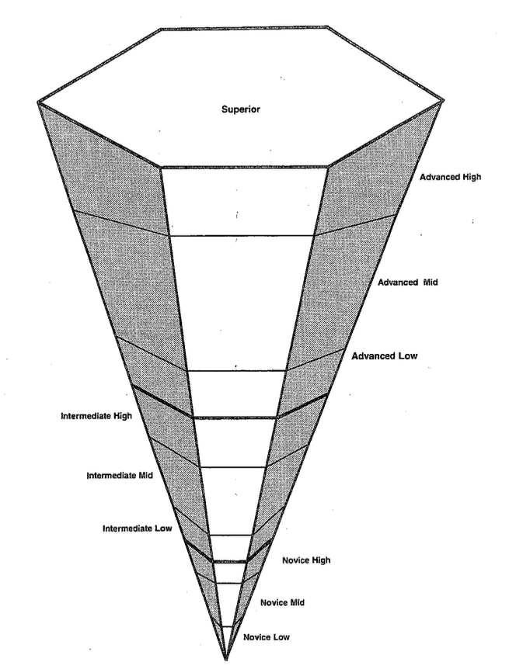
Sublevels in Rating

Slide 9
Sublevels in Assessment Design

Slide 10
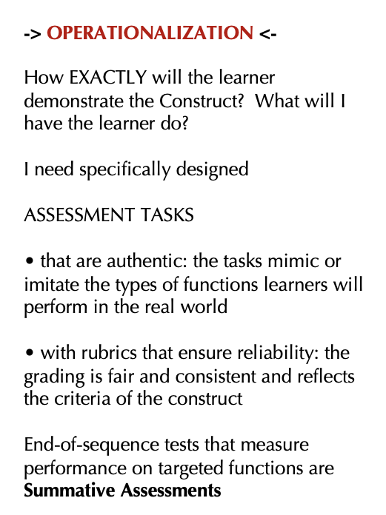
Intermediate Speaking
create with language
carry on a conversation
ask questions
answer questions
get through a transaction
produce strings of discrete sentences
about personal, everyday topics
in familiar, informal contexts
accurate enough for sympathetic
listener
How can I get the EVIDENCE I need to be able to claim my learners are at this level? How will I OPERATIONALIZE the criteria “intermediate speaking”?
Operationalization

Slide 11
Intermediate Speaking Operationalization 1
• give students a list of 8-9
Intermediate-level questions
• give students list of 2-3
intermediate-level role plays
• students choose 2 questions
and one of the role plays, produce a recording and upload it to the LMS
Intermediate Speaking Operationalization 2
• give students a list of 8-9 Intermediate-level questions
• give students list of 2-3
intermediate-level role plays
• students come to my office
and I choose 2-3 of the questions
and one of the role plays and
conduct the interview

Slide 12
Intermediate Speaking Criteria
• create with language
• carry on a conversation
• ask questions
• answer questions
• get through a transaction
• produce strings of discrete sentences
• about personal, everyday topics
• accurate enough for sympathetic listener
“Threshold” OPI for Intermediate
• F2F with one student
• warm-up
• 2-3 questions eliciting Intermediate language
• 1 role play
• wind down

Slide 13
Effective Intermediate-Level Questioning Strategies
Remember, you are eliciting evidence of the ability to:
create with language
carry on a conversation
ask questions
answer questions
get through a transaction
produce strings of discrete sentences
about personal, everyday topics
in familiar, informal contexts
accurate enough for sympathetic listener

Slide 14
Effective Intermediate-Level Questioning Strategies
You said you have a brother.
What is his name?
How old is he?
Does he go to school?
Where?
create with language
carry on a conversation
ask questions
answer questions
get through a transaction
produce strings of discrete
sentences
about personal, everyday
topics
in familiar, informal contexts
accurate enough for
sympathetic listener
You said you have a brother.
Can you tell me about him?
Are you and your brother more alike? Or different? Why?

Slide 15
A Closer Look 🔬 at the Role Play
Threshold OPI for Intermediate
• F2F with one student
• warm-up
• 2-3 questions eliciting Intermediate language
• 1 role play
• wind down
what functions does the role play elicit?
why does the role play come toward the end of the interview?
how to choose from the 3-4 role plays you will develop in this workshop
role play
• create with language • carry on a conversation •ask questions • answer questions
• get through a transaction • produce strings of discrete sentences • about personal, everyday topics
• in familiar, informal contexts •accurate enough for sympathetic listener

Slide 16
Thank you!
Questions?
ccbauman@uchicago.edu
https://www.languages.uchicago.edu

