Slide 1
Federal Funding for Language Programs
Southeast Asian Language Teaching:
Sustainability through Collaboration
Brian Cwiek
September 21, 2024

Slide 2
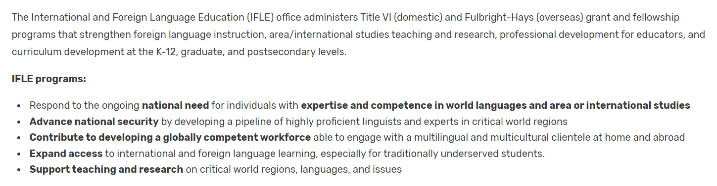




https://www.ed.gov/about/ed-offices/ope/ifle
@GoGlobalED
IFLE@ed.gov

Slide 3
Funding Overview, part 1 - Structures
Infrastructure
  Language Resource Centers (LRC) [ED]
  National Resource Centers (NRC) [ED]
  Centers for International Business Education (CIBE) [ED]
  AORC/CAORC [ED, State +]
Institutions
  Undergraduate International Studies and Foreign Language (UISFL) [ED]
  Fulbright-Hays Group Projects Abroad, Long-term [ED]
  Project GO [DoD-DLNSEO]
  Language Training Centers (LTC) [DoD-DLNSEO]
  Language Flagship [DoD-DLNSEO]
  Humanities Initiatives at Colleges and Universities [NEH]
  STARTALK [NSA]
Language Materials Development
  International Research and Studies (IRS) [ED]
  Dynamic Language Infrastructure-Documenting Endangered Languages (DLI-DEL) [NEH-NSF]
  Dynamic Language Infrastructure-Doctoral Dissertation Research Improvement Grants (DLI-DDRI) [NSF]
https://www.ed.gov/about/ed-offices/ope/ifle
@GoGlobalED
IFLE@ed.gov

Slide 4
Funding Overview, part 2 - People
Faculty/Educators
  Fulbright-Hays Faculty Research Abroad (FRA) [ED]
  Fulbright Scholars/Educators programs [State]
  Cultural Anthropology Program Senior Research Awards (CA-SR) [NSF]
  Stimulating Diversification in Language Science Research (LangDiv) [NSF]
  Institutes for Higher Education Faculty [NEH]
  Institutes for K-12 Educators [NEH]
  Fulbright-Hays Group Projects Abroad, Short-term [ED]
Student Projects
  Foreign Language and Area Studies Fellowships (FLAS) [ED]
  Fulbright Student programs [State]
  Fulbright-Hays Doctoral Dissertation Research Abroad (DDRA) [ED]
  Boren awards [DoD – DLNSEO]
  Gilman Scholarship/Critical Need Language Award [State]
  Critical Language Scholarships (CLS) [State]
  Cultural Anthropology Program - Doctoral Dissertation Research Improvement Grants (CA-DDRIG) [NSF]
  Linguistics Program - Doctoral Dissertation Research Improvement Grants (Ling-DDRI) [NSF]
  Cultural Anthropology Research Experience for Graduates (REG) and Research Experience for Undergraduates (REU) Supplements [NSF]
  National Security Language Initiative for Youth (NSLI-Y) [State]
https://www.ed.gov/about/ed-offices/ope/ifle
@GoGlobalED
IFLE@ed.gov

Slide 5






Slide 6
Language Resource Centers - Overview
Agency: Department of Education
Purpose: This program provides grants for establishing, strengthening, and operating centers that serve as resources for improving the nation's capacity for teaching and learning foreign languages through teacher training, research, materials development, and dissemination projects.
Eligibility: An institution of higher education or a combination of institutions of higher education is eligible to receive an award under this part.
Next competition: Early Federal FY 2026, CY Fall 2025 (anticipated)
Online information:
  https://www.ed.gov/grants-and-programs/grants-higher-education/ifle/language-resource-centers
  http://www.nflrc.org/
Regulations: eCFR :: 34 CFR Part 669 -- Language Resource Centers Program
https://www.ed.gov/about/ed-offices/ope/ifle
@GoGlobalED
IFLE@ed.gov

Slide 7
Language Resource Centers - Activities
Activities include effective dissemination efforts, whenever appropriate, and may include:
  Research and dissemination of new and improved teaching methods, including educational technology;
  Development and dissemination of new teaching materials;
  Development, application, and dissemination of performance testing;
  Training of teachers in the administration and interpretation of performance tests, the use of effective teaching strategies, and the use of new technologies;
  Significant focus on the needs of those who are teaching and learning the less commonly taught languages;
  Development and dissemination of materials designed to serve as a resource for foreign language teachers at the elementary school and secondary school levels; and
  Operation of intensive summer language institutes.
https://www.ed.gov/about/ed-offices/ope/ifle
@GoGlobalED
IFLE@ed.gov

Slide 8
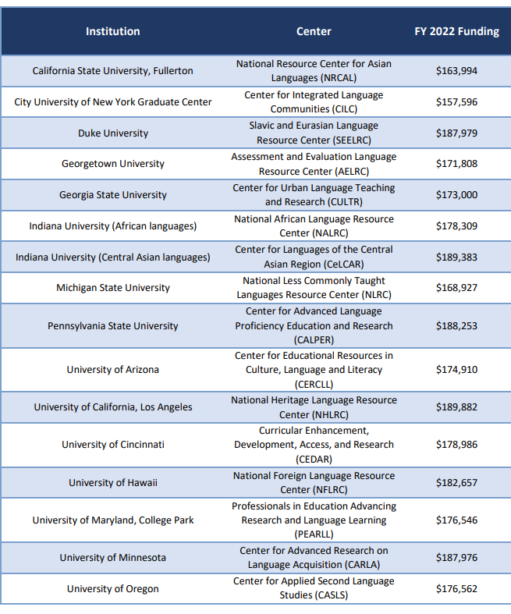
Project Descriptions
Awards -- Language Resource Centers (ed.gov)

Slide 9

Language Resource Centers – Example 1
The Center's mission is to serve the entire community of African language educators and learners in the United States by sponsoring a wide range of educational and professional activities designed to improve the accessibility and quality of African language instruction. The Center encourages a variety of pedagogical approaches to accommodate learner diversity, and advocates the integration of language and culture learning and the acquisition of fluency in these areas. It facilitates dialogue among teachers, learners, and administrators from a wide variety of cultural and institutional perspectives, while also promoting the profession of African language teaching.
https://www.ed.gov/about/ed-offices/ope/ifle
@GoGlobalED
IFLE@ed.gov

Slide 10

Language Resource Centers – Example 2
Established in 1999 and operated by Duke University, the Slavic and East European Language Resource Center (SEELRC) has as its mission the improvement of the national capacity to teach and learn Slavic and East European languages. The Center accomplishes this by developing teaching and assessment materials as well as by supporting research and a variety of activities, including undergraduate and graduate education and exchange programs, conferences, seminars, and public outreach programs. The SEELRC is one of 15 Title VI funded Language Resource Centers.
https://www.ed.gov/about/ed-offices/ope/ifle
@GoGlobalED
IFLE@ed.gov

Slide 11
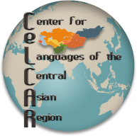
Language Resource Centers – Example 3
Indiana University’s Center for Languages of the Central Asian Regions (CeLCAR) was founded in 2002. Our mission is to foster interest in and knowledge of Central Asian languages and their cultures while meeting strategic national needs. It is one of sixteen Title VI Language Resource Centers in the United States and the only one dedicated to the critical languages of Central Asia and surrounding countries. CeLCAR is dedicated to promoting the teaching and learning of the languages and cultures of Central Asia through the development of language learning materials (textbooks, workbooks, phrasebooks, multimedia resources, web and mobile applications, online courses), teacher training, and intensive language summer courses.
https://www.ed.gov/about/ed-offices/ope/ifle
@GoGlobalED
IFLE@ed.gov

Slide 12

Language Resource Centers – Example 4
National Resource Center for Asian Languages (NRCAL) was established in 2014 to improve the nation’s capacity for the teaching and learning of Asian languages including Vietnamese, Korean, Chinese, Japanese, and Khmer.
https://www.ed.gov/about/ed-offices/ope/ifle
@GoGlobalED
IFLE@ed.gov

Slide 13
Language Resource Centers - Summary
Advantages
  Focused on language and compatible with regional focus
  Flexible range of allowable activities
  Relatively stable four-year funding cycle
  Open to consortia of colleges/universities
  Potential to work with non-regional LRCs (assessment, heritage, OER, technology)
Limitations
  Competitive, application burden
  Tied to one or more colleges/universities
  Four-year competition cycle
  Less than $200,000 per year
https://www.ed.gov/about/ed-offices/ope/ifle
@GoGlobalED
IFLE@ed.gov

Slide 14
National Resource Centers - Overview
Agency: Department of Education
Purpose: The program provides grants to establish, strengthen, and operate language and area or international studies centers that will be national resources for teaching any modern foreign language. Grants support: instruction in fields needed to provide full understanding of areas, regions or countries; research and training in international studies; work in the language aspects of professional and other fields of study; and instruction and research on issues in world affairs.
Eligibility: An institution of higher education or a consortium of institutions of higher education is eligible to receive an award under this part.
Next competition: Early Federal FY 2026, CY Fall 2025 (anticipated)
Online information:
  https://www.ed.gov/grants-and-programs/grants-higher-education/ifle/national-resource-centers
  Regulations: eCFR :: 34 CFR Part 656 -- National Resource Centers Program for Foreign Language and Area Studies or Foreign Language and International Studies
https://www.ed.gov/about/ed-offices/ope/ifle
@GoGlobalED
IFLE@ed.gov

Slide 15
National Resource Centers - Summary
Advantages
  Focused on area studies and language
  Almost endlessly flexible range of allowable activities
  Relatively stable four-year funding cycle
  Open to consortia of colleges/universities
  Potential to expand number of funded centers with regional focus
Limitations
  Very broad range of allowable activities and commitments
  Resources at current/reapplying NRCs already committed
  Competitive, application burden
  Tied to one or more colleges/universities
  Four-year competition cycle
https://www.ed.gov/about/ed-offices/ope/ifle
@GoGlobalED
IFLE@ed.gov

Slide 16
Common Limitations of Federal Programs
Available funding is transparent but potentially highly variable because all funds come from Congressional appropriations.
Program purposes and design tend to be fixed by statutes and regulations.
Each agency administers programs independently. Units/teams within agencies may administer programs independently. Contractors may assist in the administration of certain programs.
Discretionary grant programs are competitive.
Each program typically has idiosyncratic application requirements and procedures.
Competitions occur on different, potentially unpredictable, schedules that are not intentionally planned to accommodate applicants with interests in multiple programs or applicants with immediate need for project funding.
Many programs are project based and will not sustain activities.
Individual and institutional programs often are uncoordinated.
Programs (especially outside ED) limit languages of interest.
https://www.ed.gov/about/ed-offices/ope/ifle
@GoGlobalED
IFLE@ed.gov

Slide 17
Potential ED/IFLE Program Interactions and Collaboration Possibilities
SA encourages personal engagement
GPA Short term builds interest and creates new networks
DDRA and FRA promote individual research overseas
Chances to recruit, build, enrich, share expertise, and expand
UISFL funds expansion of programs at IHEs, including MSIs and CCs
GPA Long term supports overseas language study
AORC supports overseas research infrastructure
IRS funds creation of language materials and educational research
Many FLAS grants strategically stimulate enrollment in language courses that utilize jointly developed teaching materials, language resources, and language assessment standards
Foundational elements of area studies and language education
Many NRCs with shared focus each provide additional expertise and limited funding as joint project activities for a regionally-focused community (Potential overlap with CIBE); outreach supports pipeline of potential students; collaboration builds capacity at other IHEs
One LRC provides organizational home for projects and activities that support a regionally-focused language education community

Slide 18
Generally Allowable Federal Expenses (2 CFR)
§ 200.454 Memberships, subscriptions, and professional activity costs.
Costs of the non-Federal entity's membership in business, technical, and professional organizations are allowable.
(b) Costs of the non-Federal entity's subscriptions to business, professional, and technical periodicals are allowable.
(c) Costs of membership in any civic or community organization are allowable with prior approval by the Federal awarding agency or pass-through entity.
(d) Costs of membership in any country club or social or dining club or organization are unallowable.
(e) Costs of membership in organizations whose primary purpose is lobbying are unallowable. See also § 200.450.
[78 FR 78608, Dec. 26, 2013, as amended at 85 FR 49569, Aug. 13, 2020]

Slide 19
More Information
Department of State Programs
Bureau of Educational and Cultural Affairs | Promoting Mutual Understanding (state.gov)
Fulbright | Bureau of Educational and Cultural Affairs (state.gov)
Homepage - Critical Language Scholarship Program (clscholarship.org)
Department of Defense Programs
About NSEP (nsepnet.org)
Request for Proposals | Project GO (rotcprojectgo.org)
Homepage | Language Training Center (dodltc.org)
Other Programs
Directorate for Social, Behavioral and Economic Sciences (SBE) | NSF - National Science Foundation
STARTALK
Dynamic Language Infrastructure - Documenting Endangered Languages Fellowships (neh.gov)
Grants Search | National Endowment for the Humanities (neh.gov)
Department of Education (IFLE) Programs
Programs Authorized Under Title VI of the Higher Education Act
Title VI programs offer domestic grants to institutions of higher education to develop and maintain capacity and performance in area/international studies and world languages.
American Overseas Research Centers
Business and International Education
Centers for International Business Education
Foreign Language and Area Studies Fellowships
International Research and Studies
Language Resource Centers
National Resource Centers
Undergraduate International Studies and Foreign Language Program
Programs Authorized Under the Mutual Educational and Cultural Exchange Act (Fulbright-Hays Act)
Fulbright-Hays programs provide overseas funding to current and prospective U.S. educators to participate in advanced overseas study and research.
Doctoral Dissertation Research Abroad Fellowships
Faculty Research Abroad
Group Projects Abroad
Seminars Abroad
https://www.ed.gov/about/ed-offices/ope/ifle
@GoGlobalED
IFLE@ed.gov

Slide 20
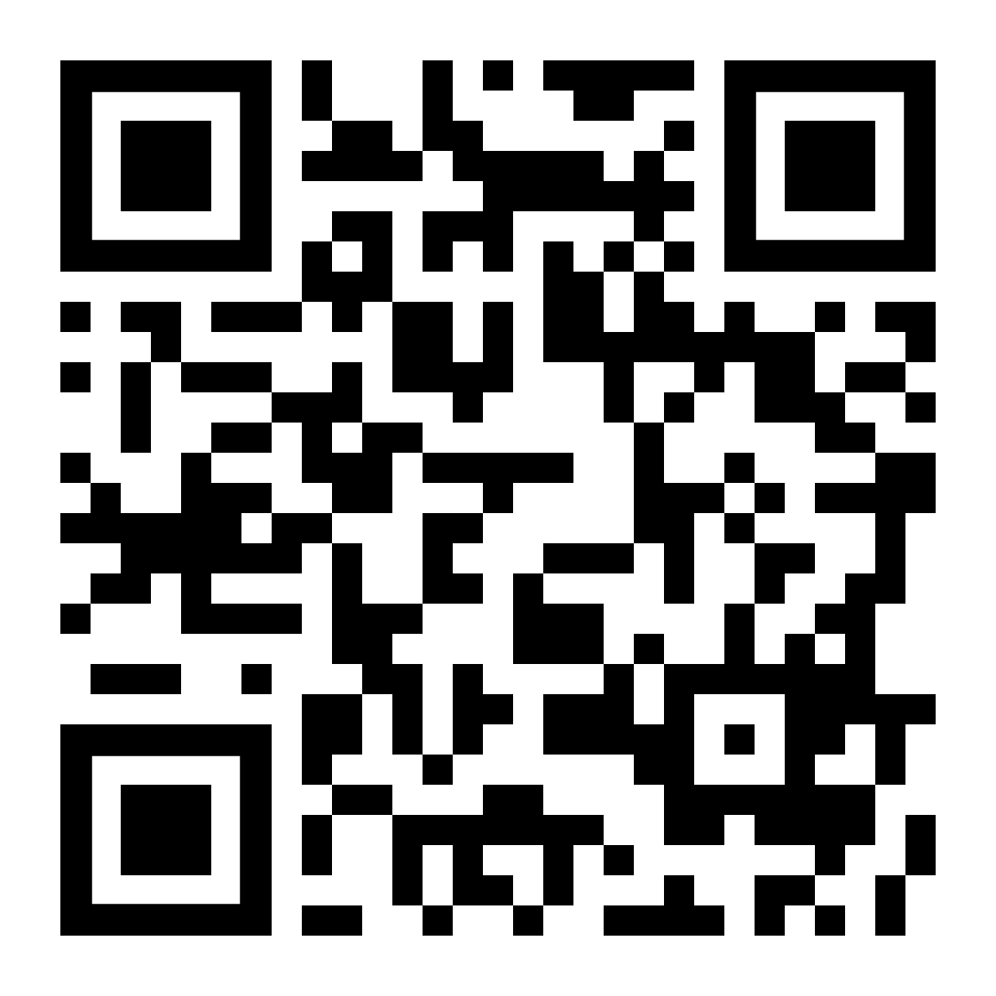



Learn More & Stay Connected
IFLE Communications
Subscribe to the IFLE Newsletter
@GoGlobalED
@GoGlobalED-IFLE
https://www.ed.gov/about/ed-offices/ope/ifle
@GoGlobalED
IFLE@ed.gov
Notes:
Subscribe to IFLE Newsletter: https://public.govdelivery.com/accounts/USED/subscriber/new?topic_id=USED_61
IFLE YouTube: https://www.youtube.com/@GoGlobalED-IFLE/featured
Meet the Fulbright-Hays DDRA & FRA Fellows (Fall 2022): https://www.youtube.com/playlist?list=PLPEFewLY3Yr9b0Aa_ay16MkLsKMtcZa5A
Go Global ED Podcast Playlist: https://www.youtube.com/playlist?list=PLPEFewLY3Yr9SSKgE0eizxLDLjfJnB-56
Meet the Fulbright-Hays DDRA & FRA Fellows (Fall 2022): https://www.youtube.com/playlist?list=PLPEFewLY3Yr9b0Aa_ay16MkLsKMtcZa5A
OER Commons (open source curricula sharing): https://www.oercommons.org/groups/international-and-foreign-language-education-resou/10416/
Go Global ED on Twitter: https://twitter.com/GoGlobalED?s=20&t=Kq_LLAeKQmnFGW2I_me5SQ
On Instagram search #FulbrightHays to see stories from F-H scholars!

