Slide 1


Troubleshooting Issues Around Rubric Design
Ahmet Dursun
Director, Office of Language Assessment

Slide 2
TASK TYPE
TASK INPUT/TEXT
TARGET FUNCTIONS
RUBRICS
TASK TOPIC
SCORING
TASK PROMPT
& DELIVERY
Everything from designing to developing an assessment task, and then from grading the task to reporting the its results MUST work in harmony to elicit the evidence that the learner can function (e.g. at the advanced level) in the TARGET LANGUAGE USE DOMAIN.

Slide 3
Things to Consider in Grading Proficiency Exams
Read the responses from the beginning to the end to have the overall sense of it
Always evaluate responses based on the corresponding rubric (even when you think you know the response very well)
Award partial credit to any evidence of criteria (as specified in the rubric), even if the complete answer is not observable
Information NOT contained in the original text should earn NO points and does NOT count as an error or cause the students to lose the points.
Notes:
You would provide a partial credit. Because every bit is counted in the proficiency as long as it is accurate or it does not change the direction of the information provided

Slide 4
READING & LISTENING
READING & LISTENING RUBRICS
How to write the answer key?
The context or student's role in the task in connection with why they would read or listen to such a thing in real life should make it clear “what counts and what does not count, what matters and what doesn’t matter” in the response.
The best way to write a response is to think yourself in the situation and context given and if you were the one asked to read or listen to such a thing,
  What would you consider important or worth remembering ? [in Summary Tables , Recall Protocols & SRQs]
  What would matter and would NOT matter to complete such a task? [in Summary Tables, Recall Protocols & SRQs]
  What would you consider as key points and supporting details? [in Summary Protocols]
  What would you keep and leave out considering to summarize the content for someone who has NOT read or listen to the text? [in Summary Protocols]
The answers to these questions are NOT independent from the purpose/goal of the task and of course the content/structure of the text. That’s why we use GRASPS model to design the tasks.

Slide 5
  Issues Around Rubric Design

Slide 6
Summary Table
Key Points:
  The rubrics need to be formatted in the same way that the summary table task has been formatted in the test.
  Each comprehension category should have an equal value.

Slide 7
Summary Table Rubric
Purpose of the call | ………………………………………………………… ………………………………………………………… ………………………………………………………… | X Points | Time for the event | ………………………………………………………… ………………………………………………………… ………………………………………………………… | X points
Place of the event | ………………………………………………………… ………………………………………………………… ………………………………………………………… | X Points | Plans after the event | ………………………………………………………… ………………………………………………………… ………………………………………………………… | X Points
Separating main ideas and supporting details in Summary Table rubrics
Not counting all the content in the rubrics towards the total points

Slide 8
Open-Ended Questions
Key Points:
  For each question, there must be a corresponding rubric.
  Depending on the structure of the question, the answers can be weighted.

Slide 9
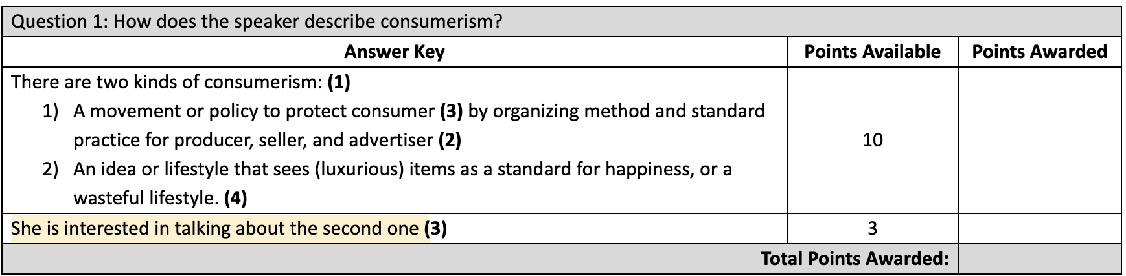
Open-ended Questions Rubric
Question 1: |  | Copy-paste the question here
Points Awarded | Points Available | Answer Key
 | X | Response part 1
 | Y | Response part 2
Total Points Awarded:
Mismatch between the question wording (i.e., what it demands) vs. the answer
Long/paragraph-level answers in one shot (i.e., not analytical enough)
Overlap between the answers of two questions (i.e., violating the principle of independence)

Slide 10
Recall Protocol
Key Points:
  For each recall protocol task, there must be a corresponding rubric.
  The recall answers CANNOT be weighted. Each comprehension points receive equal value.

Slide 11
Recall Protocol Rubric
Points Awarded | Points Available | Expected Response
 | X
 | X
 | X
 | X
 | X
Total Points Awarded:
Inferencing vs. reproducing
Full sentences vs. idea units
Weighting different idea units differently
Not counting all the content in the rubrics towards the total points
Notes:
Anything that is not explicitly stated should not count.

Slide 12
Summary Protocol
Key Points:
  For each summary protocol task, there must be a corresponding rubric.
  The rubric consists of two main sections: Main/Key Ideas and Supporting Details.
The SP rubric is weighted. Main ideas should receive more points than supporting details.
A main idea might have more/less weight than another depending on its importance to the text.
However supporting details have the SAME point value.
The order of the ideas, word-choice, and writing quality are IRRELEVANT

Slide 13
Summary Protocol Rubric
Points Awarded | Points Available
 | X | Main idea 1
 | Z |  | Supporting detail 1
 | Z |  | Supporting detail 2
 | X | Main idea 2
 | Z |  | Supporting detail 1
 | Z |  | Supporting detail 2
 | X | Main idea 3
 | Z |  | Supporting detail 1
 | Z |  | Supporting detail 2
 | Y | Main idea 4
 | Z |  | Supporting detail 1
 | Z |  | Supporting detail 2
Total Points Awarded:
Not separating main ideas/key points from supporting details
Putting main ideas as a title (i.e., not as a statement)
Summarize vs. reproduce
Minute point values (e.g., .25 pts)
Notes:
Anything that is not explicitly stated should not count.

Slide 14
Questions from the Presentations
How specific should the student answer be to get the full credit? (Student wording vs. rubric wording)
No word for word translation
Not word for word reproduction (producing in their own words not your words)
Always look at the meaning (not their word-by-word comprehension)
How to ensure clarity, consistency, and fairness in grading?
Can we use this test/proficiency tests as a placement?

