Slide 1

Proficiency Familiarization
SEALC Proficiency Assessment Project
January 12/13, 2024
Catherine Baumann, Director, Chicago Language Center
University of Chicago Language Center

Slide 2

What do we mean by the term “proficiency”?
Example: Learning to Drive
Learning about driving | Learning to drive the car
Rules of the road Happens in the classroom Manuals, online learning Discussions, quizzes Assessment = Written test | Driving! Happens out in the car Different skills each day Learn by doing Assessment = Driving test
Proficiency

Slide 3
Language Proficiency
Learning about language | Learning to use language
Grammar Vocabulary Writing systems Pronunciation Conventions Culture Assessment = Achievement test | Communicating Practicing real-world skills Interacting Reading, writing, speaking, listening Learn by doing Assessment = Proficiency test
Proficiency

Slide 4
Key proficiency assessment concepts
achievement and proficiency
Proficiency Assessment

Slide 5
FILR Scale (FSI) | ACTFL Levels (OPI)
5 = Educated Native Speaker 4 = Distinguished Proficiency (4+) 3 = Professional Proficiency (3+) 2 = Limited Working Proficiency (2+) 1 = Survival Proficiency (1+) 0 = No Functional Proficiency (0+) | Superior Advanced (Low, Mid High) Intermediate (Low, Mid, High) Novice (Low, Mid, High)
Proficiency

Slide 7
Key proficiency assessment concepts
achievement and proficiency
norm referenced and criterion referenced testing
Proficiency Assessment

Slide 8
What does an ACTFL OPI look like?
The structure of an Oral Proficiency Interview

Slide 9
Key proficiency assessment concepts
achievement and proficiency
norm referenced and criterion referenced testing
discrete testing and global assessment
Proficiency Assessment

Slide 11
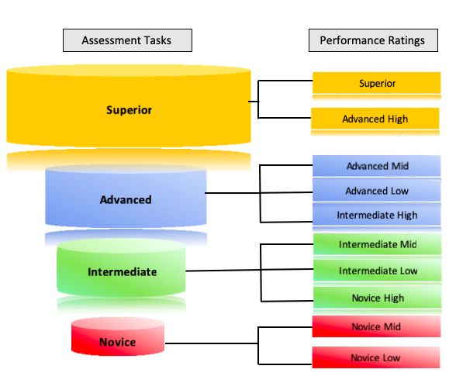

Slide 12
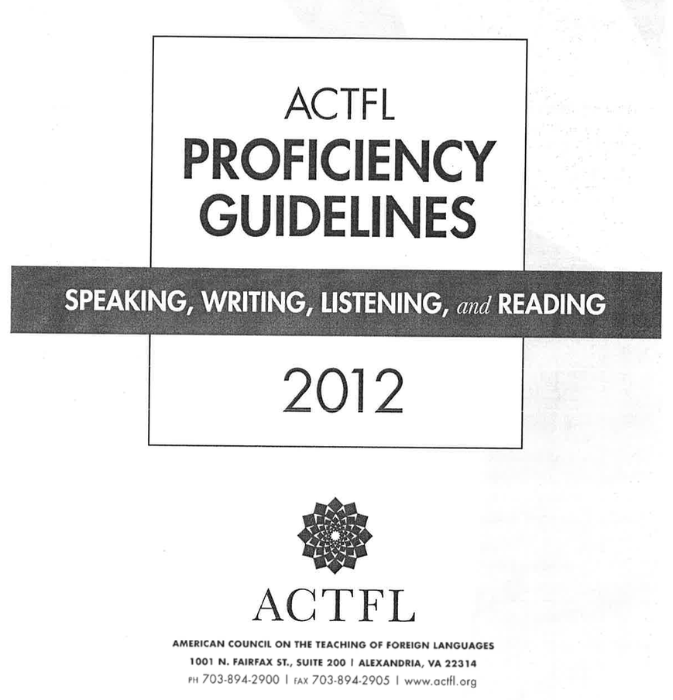

Slide 13
Intermediate Speaking | Advanced Speaking
• tell detailed stories in different time frames (i.e. narration)
• describe places, people, processes, institutions in detail
• get through a situation with a complication
• topics include both personal and public interest
• language is cohesive and organized (i.e. paragraphs)
• can be understood by anyone – still make errors!
• create with language
• carry on a conversation
• ask questions
• answer questions
• get through a transaction
• produce strings of discrete sentences
• about personal, everyday topics
• accurate enough for sympathetic listener
Proficiency

Slide 14
Intermediate Writing | Advanced Writing
• create with language to produce simple written communication
• ask questions, answer questions
• produce strings of discrete or loosely connected sentences
• personal, everyday settings
• manage simple transactions for social or personal needs
• requires a sympathetic reader, first language influence is evident
• narrations and descriptions
• clearly indicates time frames
• discourse is cohesive and organized
• personal and public (general) interest topics
• appropriate to informal and many formal, academic or profession settings
• can manage a complication or problem
• comprehensible without difficulty by anyone in the target culture
Proficiency

Slide 15
Intermediate Comprehension | Advanced Comprehension
• comprehends speech or written language that conveys basic information simply
• comprehends loosely connected sentences, questions, phrases or idea units
• at ease with a broad range of topics pertaining to daily life, personal and social transactions
• understands adequately, both the overall message as well as some details, despite gaps and misunderstandings
• comprehends descriptions and narrations that convey information with some complexity, including timeframes and main ideas and supporting details
• comprehends discourse that uses multiple cohesive devices
• topics include personal and public interest, including some in professional or academic settings
• understands and differentiates the overall message and details, accommodating occasional gaps and misunderstandings using contextual clues and other knowledge
Proficiency

Slide 16
What are the Proficiency Guidelines? What are they NOT?
They are:
descriptions of what individuals can do with language in the four skills in real-world situations in a spontaneous and non-rehearsed context
an instrument for the evaluation of functional language ability
But – they are:
not based on any theory, method, or curriculum
not a description of how an individual learns a language
not tied to number of years of instruction
  a course called “Advanced German” does not equate to the Advanced level
not a curriculum
not an emphasis on Speaking
not an endorsement to ignore grammar

Slide 17
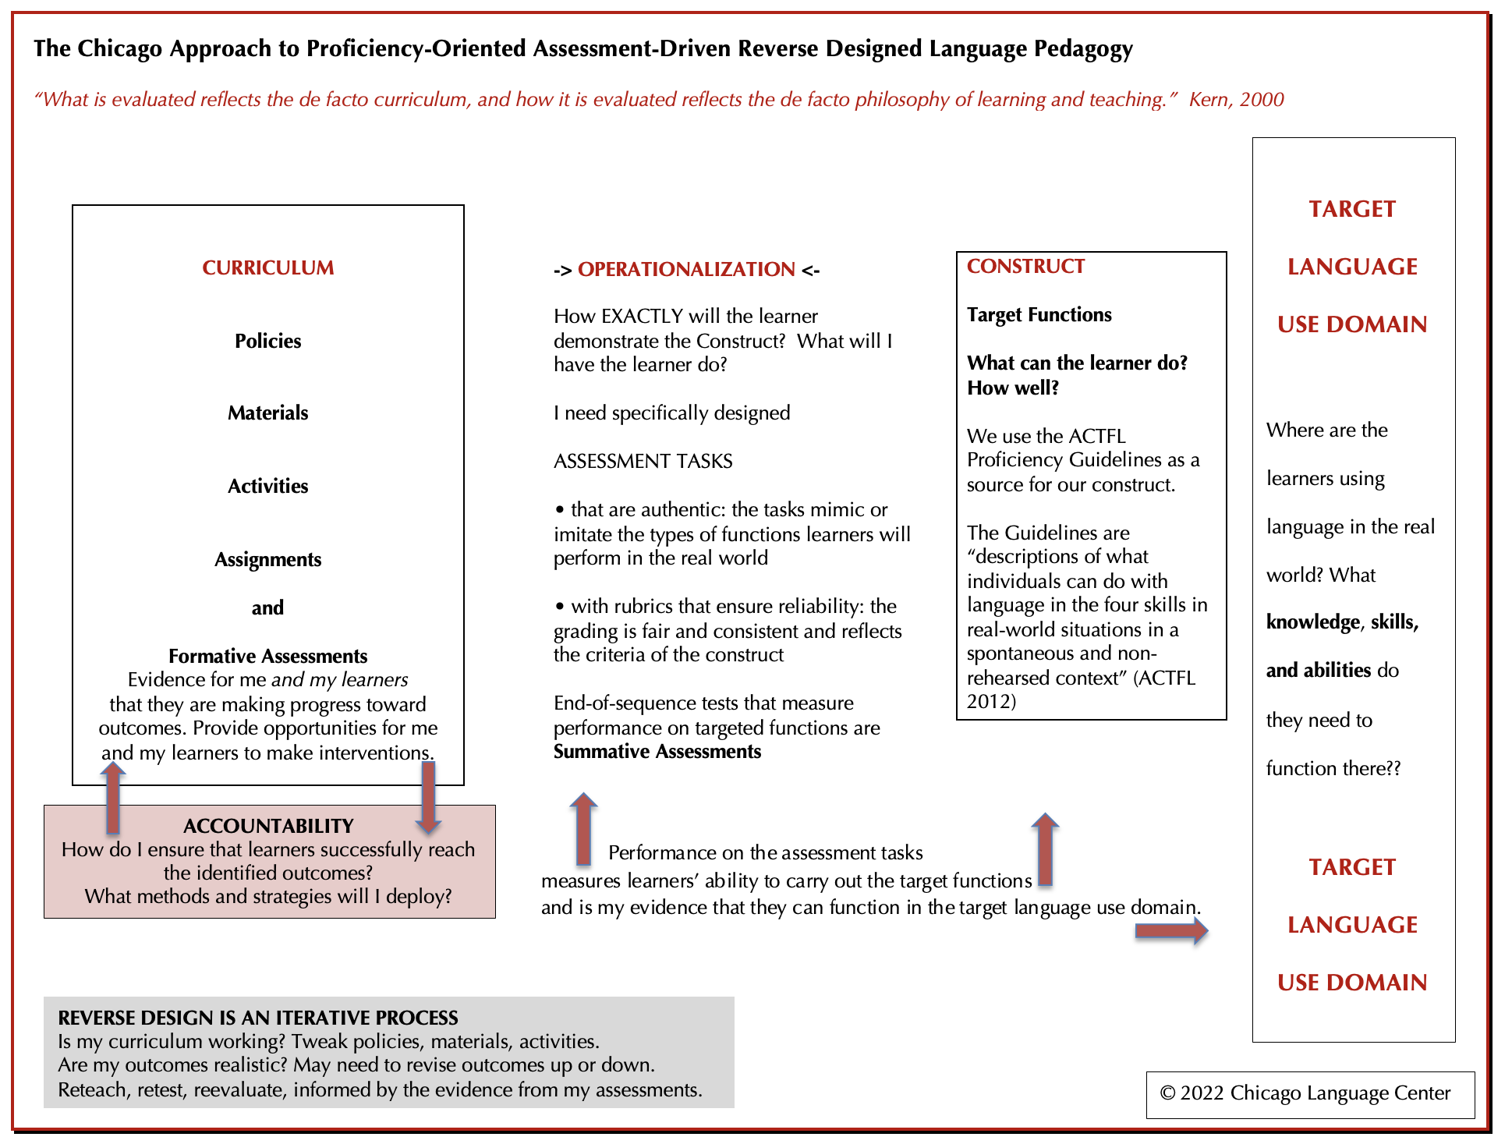

Slide 18
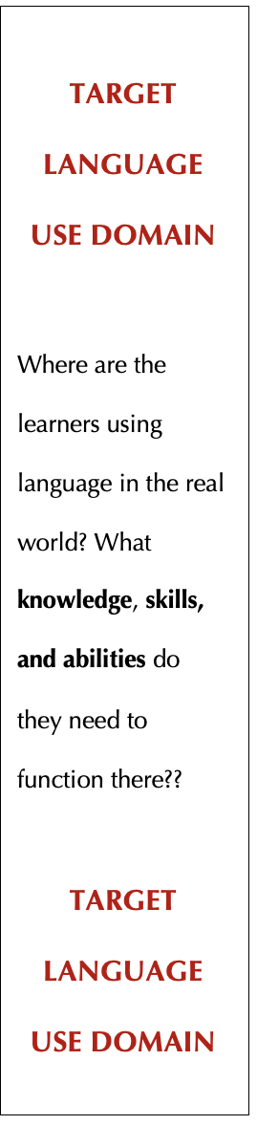
Why “real world” language skills?
our outward face, our own goals
our promise to our students
this is what our students are doing with language
lets us tie language learning to real-world language use
lets us talk about language skills in real world terms, not just an “A”
makes it clear that learning a language and its culture is something our students can take out into the world with them
What is the Target Language Use Domain for our learners?
What are other examples of Target Language Use Domains?
Proficiency

Slide 19
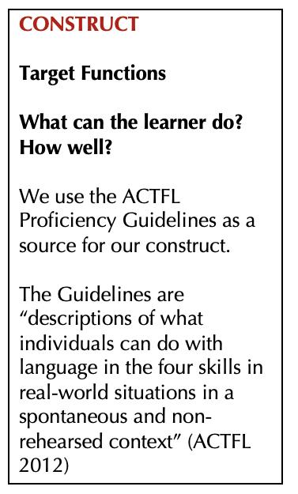
We can use the Proficiency Guidelines
• descriptions of outcomes at different levels of proficiency
• been around for almost 40 years
• have been validated
• if we had to create our own, we would have to observe learners, collect their behaviors, compare with other groups, see if they are stable…would take YEARS
• if your learners will be functioning in a different domain, you may need a domain analysis to identify the KSAs and define the construct
Proficiency

Slide 20
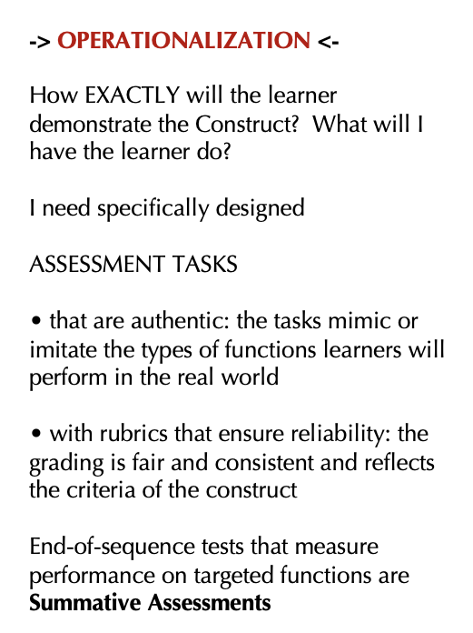
Operationalization refers to the act of turning the construct into assessment tasks.
When I operationalize the construct, I am telling my learners: this is what Speaking in the language is. Or, this is what it means to read in the language.
Ideally, operationalized constructs are authentic and valid.
The way you operationalize the construct has an impact on how your learners define the skill, and how they will prepare for your test.
Proficiency

Slide 21
For example – Intermediate Low Speaking
• create with language
• carry on a conversation
• ask questions
• answer questions
• get through a transaction
• produce strings of discrete sentences
• about personal, everyday topics
• accurate enough for sympathetic listener
How can I get the EVIDENCE I need to be able to prove my learners are at this level? How will I OPERATIONALIZE the construct “intermediate low speaking”?
Proficiency

Slide 22
IL Speaking Operationalization 1
• give students a list of 8-9 Intermediate-level questions
• give students list of 2-3 intermediate-level role plays
• students choose 2 questions and one of the role plays, produce a recording and upload it to the LMS
IL Speaking Operationalization 2
• give students a list of 8-9 Intermediate-level questions
• give students list of 2-3 intermediate-level role plays
• students come to my office and I choose 2-3 of the questions and one of the role plays and conduct the interview
Proficiency

Slide 23
Intermediate Low Speaking
“Threshold” OPI for IL
• F2F with one student
• warm-up
• 2 questions eliciting Int language
• 1 role play
• wind down
• create with language
• carry on a conversation
• ask questions
• answer questions
• get through a transaction
• produce strings of discrete sentences
• about personal, everyday topics
• accurate enough for sympathetic listener
Proficiency

Slide 24
What different performances might I get when I administer this interview?
“Threshold” OPI for IL
• F2F with one student
• warm-up
• 2 questions eliciting Int language
• 1 role play
• wind down
The speaker can perform at the intermediate level most of the time, but not consistently.
NH
The speaker can consistently perform at the intermediate level, and their language has quality and quantity.
IM
The speaker performs at the intermediate level, at a baseline level, but consistently.
IL
Proficiency

Slide 27
Intermediate Comprehension | Advanced Comprehension
• comprehends speech or written language that conveys basic information simply
• comprehends loosely connected sentences, questions, phrases or idea units
• at ease with a broad range of topics pertaining to daily life, personal and social transactions
• understands adequately, both the overall message as well as some details, despite gaps and misunderstandings
• comprehends descriptions and narrations that convey information with some complexity, including timeframes and main ideas and supporting details
• comprehends discourse that uses multiple cohesive devices
• topics include personal and public interest, including some in professional or academic settings
• understands and differentiates the overall message and details, accommodating occasional gaps and misunderstandings using contextual clues and other knowledge
Proficiency

Slide 28
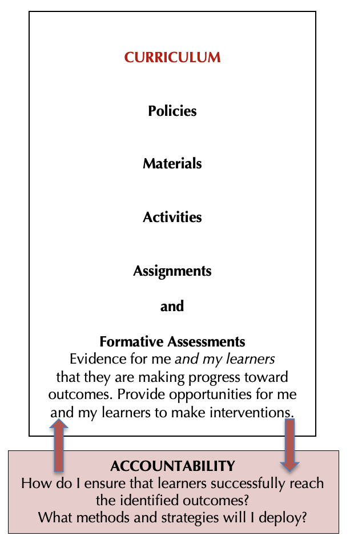

Slide 29
Usefulness of end-of-sequence proficiency assessments and the evidence they provide
help me make decisions about curriculum based on sound reverse design principles
help me evaluate the effectiveness and articulation of my curriculum based on evidence
allow me to determine whether my learners have reached my identified outcomes
maintain consistency in multi-section courses while allowing for individual instructor differences
allow me to gauge whether outcomes from sequence to sequence are attainable
if I adjust or change my curriculum, I can see if there is an impact on learner performance
inform the design of activities I do with students
inform the types of formative assessments I need
inform choices of materials and curriculum design for the next sequence, because I have an accurate picture of the skills students are bringing with them
I can tell my learners more than just their grade – I can tell them what they can do with language in the real world
I can talk to others who teach my language – or who teach other languages – about outcomes, assessment, and curricula

Slide 30
Thank you!!
Questions?
ccbauman@uchicago.edu
Good Night!!
Proficiency

